Slide 1


Online Exam Mobile App with Proctoring
Presented by:
Ramchandran.V(192321108)
ITA0302 MOBILE COMPUTING

Slide 2
Introduction
Overview of the Project:
This project involves developing a mobile application for conducting secure online examinations, integrated with a proctoring system. The app will enable students to attend exams remotely while ensuring academic integrity through AI-based monitoring, camera access, and identity verification.
Problem Statement:
Traditional online exam platforms lack robust security and real-time proctoring features, leading to increased chances of malpractice. Institutions need a reliable, scalable solution to conduct assessments that simulate an invigilated environment.
Purpose of the Project:
To build a user-friendly and secure mobile exam application that supports exam delivery, student monitoring, and cheating detection through advanced proctoring features like live video, screen monitoring, and AI-based alerts.

Slide 3
Objectives
Develop a secure mobile app for administering online exams.
Integrate live video/audio proctoring to prevent cheating.
Provide real-time identity verification using facial recognition or OTP.
Include features for timed exams, question randomization, and automatic submission.
Ensure data encryption and cloud-based result storage.
Notify instructors of suspicious activities during exams
Design for scalability to accommodate multiple institutions and exam types.

Slide 4
Literature Review / Background
The rise in remote Education, online examination tools have become essential. Existing solutions like Google Forms, Moodle, and Zoom-based proctoring are either not secure or not user-friendly. Studies show that integrating AI-based proctoring improves exam integrity and student accountability. Proctoring tools like Mettl and Examity are leading the way, but most are web-based and not optimized for mobile use. This project fills the gap by creating a mobile-first, secure, and intelligent exam system.

Slide 5
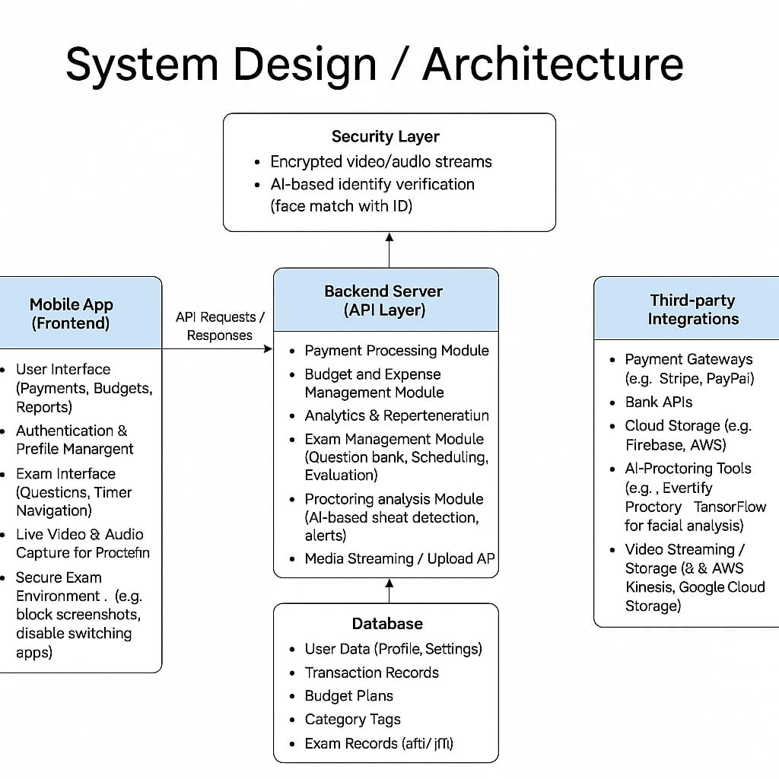

Slide 6
BENEFITS
Secure Remote Exams: Proctoring discourages malpractice and ensures fairness.
Convenience: Students can take exams from anywhere.
Scalability: Easily deployable across institutions.
Real-time Monitoring: Live data gives administrators control.
Automated Results: Reduces manual workload and errors.

Slide 7
CONCLUSION
The proposed Online Exam Mobile App provides a secure, scalable, and efficient solution for modern education systems. With its integrated proctoring features and mobile-first approach, it ensures exam integrity while offering a seamless user experience. It is designed to adapt to evolving academic and technological needs.

